Slide 1
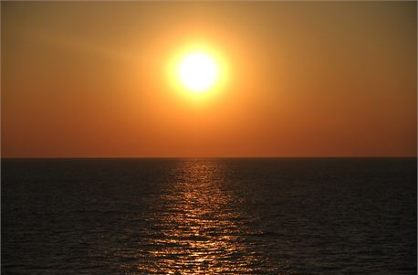
How to Honor God
Ecclesiastes 5:1-7
Dr. Rick Griffith • Crossroads International Church Singapore
CICFamily.com • BibleStudyDownloads.org

Slide 2
Wife to Counselor…
What do you mean?
I want a divorce because my husband treats me just like he does Jesus!
Well, I get 20 seconds of the same comments before every meal, half-hearted praise, one-way conversation for ten minutes a week… and every time I start to speak his eyelids droop and he's on his way to slumber land!
Notes:
The disgusted wife complained to the marriage counselor…

Slide 3
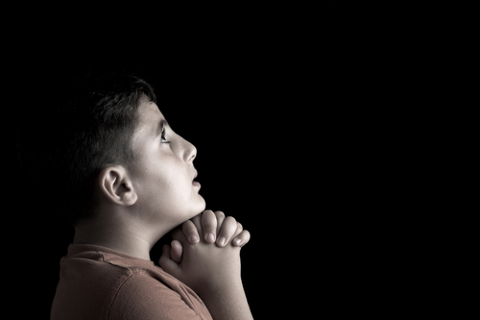
"Dear God, we had a good time at church today, but I wish you had been there."
Notes:
A little boy once attended church with his father one Sunday morning. That night before he got into bed he kneeled at his bedside and prayed…

Slide 4
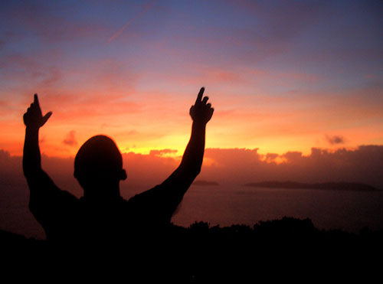
Do you struggle worshipping God?
Notes:
Obviously God is there when we attend church, and God is there when we approach Him in our own personal quiet time.
But unfortunately, we often don’t recognize His presence and sometimes we even end up in slumber land.

Slide 5
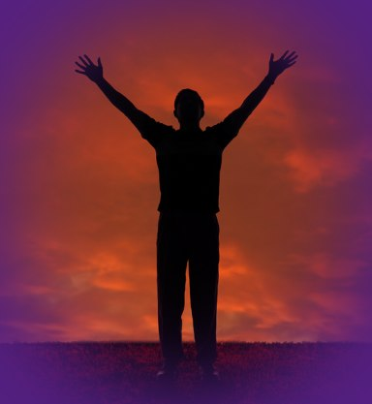
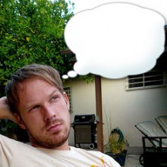
Awe!
Blah!
Notes:
We don’t mean to be disrespectful, but often we are. We know we should burst forth in awe of God, but instead, our thoughts wander, we yawn, and we go through the same motions and mutter the same clichés.
• Rather than awe, it's blah!

Slide 6
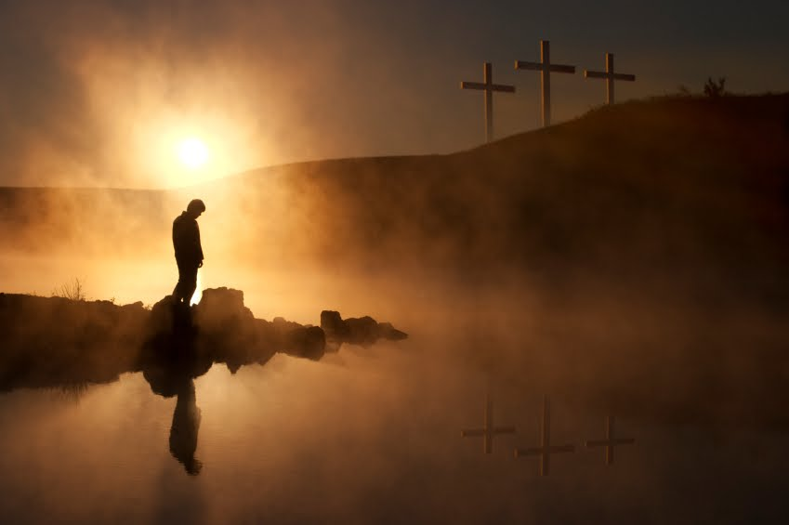
How can we honor God?
Notes:
What are the ingredients of a true reverence for God?

Slide 7
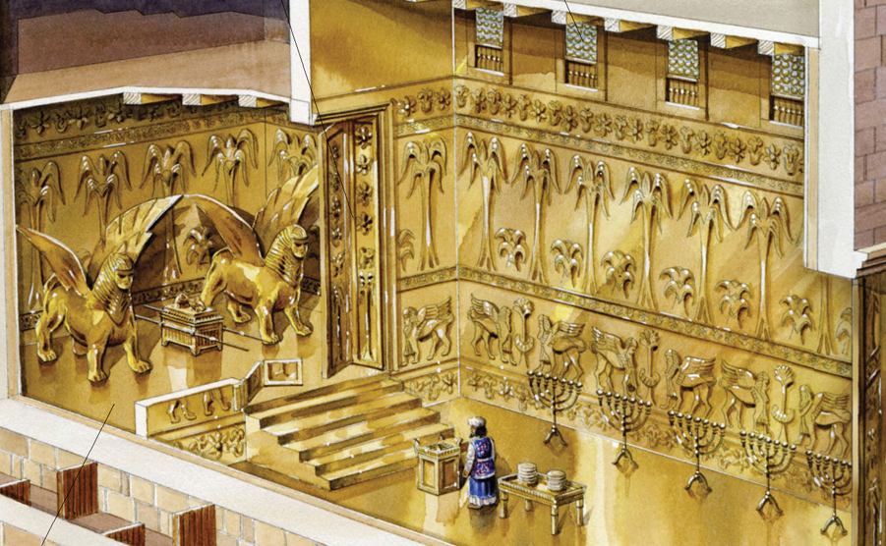
Solomon's Temple
Notes:
This is a subject that is as old as time itself. Jews struggled with this question of genuine worship in Solomon’s day just as we do.
The ones who first read today’s text probably had seen Solomon’s temple erected before their eyes. They had witnessed firsthand the tons of gold, silver, ornate carvings, precisely cut massive stones, and seen the reorganized priesthood.

Slide 8
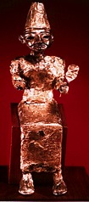
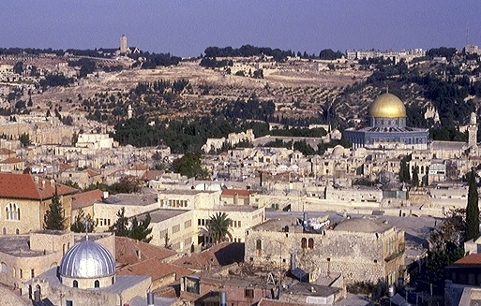



IDOL WORSHIP!
1 Kings 11:4-13
ROYALTY
The Mount of Olives
ca. 1000 B.C.
S - D - S
DC
2 Sam. 7: 4-16
1 Chron. 17:3-15
A R C
The Temple Mount
ROYALTY
S - D - S
Handbook pg. 32-37
38
4
Notes:
And yet in that very generation, worship degenerated. People came to the temple and uttered their pious words without thinking. Even across the Kidron Valley was Solomon built a palace and pagan altar for his pagan wife, Pharaoh’s daughter. False worship was right across from where the temple stood!
____________
Why? Along with Solomon's many foreign treaties he had also acquired many foreign wives from the country with which he made the treaty. The new wives moved into Jerusalem bringing with them their idolatrous religious practices.
//// On that site of today's Temple Mount…after SOLOMON had completed the first Temple to the God of Israel – and worshiped there - he later could be seen…
//// …over on The Mount of Olives across the Kidron Valley from his newly built temple…
//// worshipping the pagan gods brought into town by those foreign wives.
//// So…once again…idol worship entered the day to day life of ancient Israel, foreshadowing other great national problems to come

Slide 9
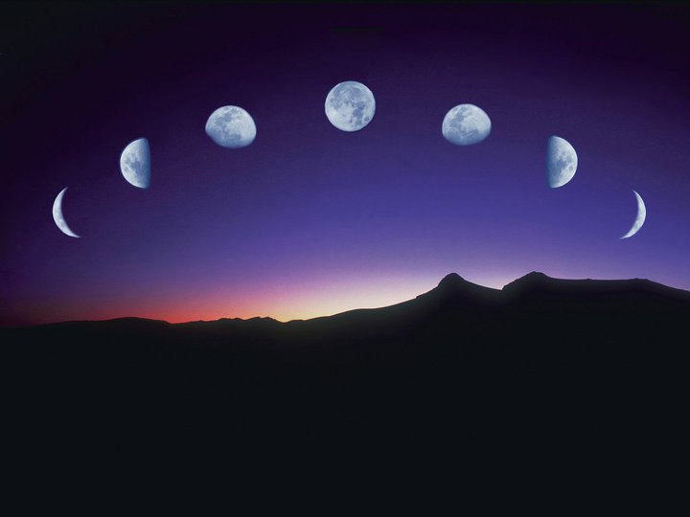
Our Study in Ecclesiastes
Work & Wisdom Don't Last
Notes:
Near the end of his life, Solomon wrote the book of Ecclesiastes—so it gives the last words we have from him. Today we’ll look at Solomon’s advice on honoring God as he saw his own failures in this area and that of his people.

Slide 10
How can we honor God?
Two ways in Ecclesiastes 5:1-7
Notes:
Today’s passage will show two ways we should honor God. Restatement: Solomon tells us how to truly honor God in Ecclesiastes 5:1-7 (passage). The Book of Ecclesiastes, chapter 5, verses 1-7. Verses 1-3 tell you to… (transition)

Slide 11
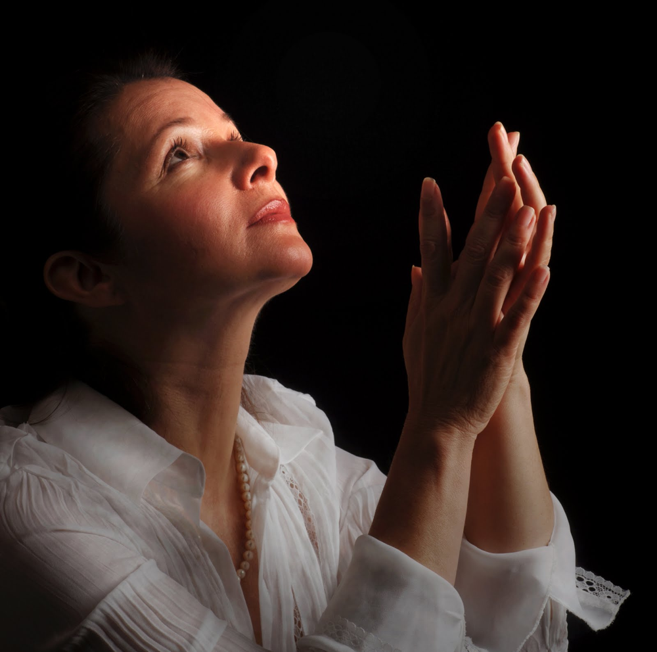
I. Honor God in your worship (1-3).
Notes:
We need to honor God by ascribing worth to Him in a way He accepts.

Slide 12
How to honor God in worship
Prepare yourself
Listen to God
Set aside cares
Notes:
Solomon gives us three tips here on proper worship. First…

Slide 13
How to honor God in worship
Prepare yourself
Notes:
Proper worship can best happen when we prepare ourselves

Slide 14
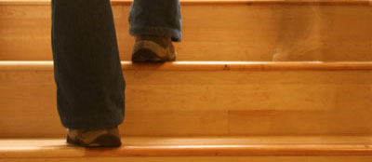
"Guard your steps when you go to the house of God" (5:1 NIV).

Slide 15
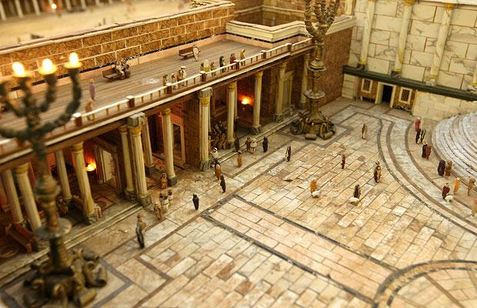
Temple Court
Notes:
The “house of God” in Solomon’s day was the Jerusalem temple. Scripture says that Solomon’s palace was right next to the temple complex. I wonder how many times Solomon had looked out his window down at the people filing into the temple courts—and many of them doing so without the slightest bit of reverence.
But there’s no temple today and the Spirit Himself indwells us, so we must apply this concept more broadly. It means whenever and wherever we approach God in worship.

Slide 16
"Guard your steps when you go to the house of God" (5:1 NIV).
"watch, observe"
Notes:
Think of how you literally have to guard your steps at times. When our sons were small, a regular one for us was when we went into our boys’ room! Who knows what wooden block or car or other toy could trip us up—especially with the lights off!
So “guard your steps” has the idea of being careful, and in this case it means that we should make sure we are properly prepared to pay homage to a holy God—to watch out for what might be tripping us up and prevent us from really worshipping God.

Slide 17
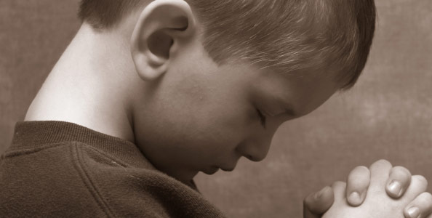
Young Christians are often better worshippers.
Notes:
One of my more disturbing observations is that young Christians seem to be better worshippers than older believers. Young lambs bounce but old sheep sulk.

Slide 18

DTS
Notes:
The same was true when I was in seminary. Once the students’ picture depicted a guy walking around campus and spotting another guy reading by the fountain. He said to himself, “Hey! There’s a guy reading his Bible between classes—must be a first year student!” The whole chapel burst out laughing, and I chuckled too. But then I began thinking, “Hey, what happened to my times of worship, praise, and Scripture reading under the trees which fed my soul those first few semesters?”

Slide 19
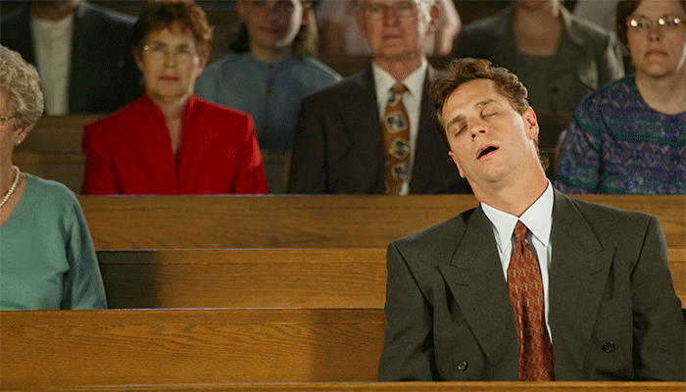
Church Lethargy
Think about some things that happened in the Bible, good or bad, while people slept:
Adam fell asleep and woke up married.
And missing a rib.
Samson fell asleep and woke up in chains. And missing his hair.
Daniel fell asleep and woke up having a vision. And looking at the angel Gabriel.
Eutychus fell asleep and woke up dead.
Notes:
I’ve found the same true in the churches. The older Christians do not necessarily make the best worshippers.
But why? I think part of the problem is that after we have known the Lord a number of years and worshipped often, we can shift into autopilot at church. Stand…sit…sing…smile…stare…sleep!
___________
http://jmarkfox.com/tag/spiritual-lethargy/

Slide 20
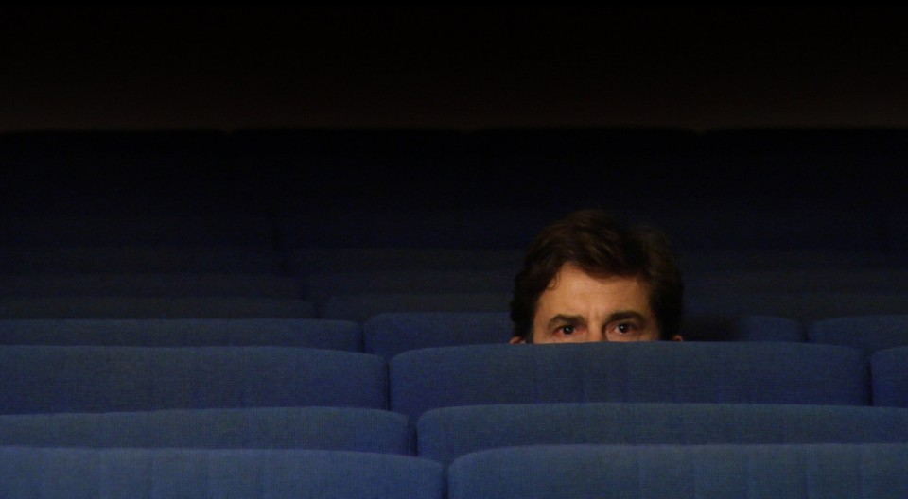
So how can you prepare to meet God?

Slide 21
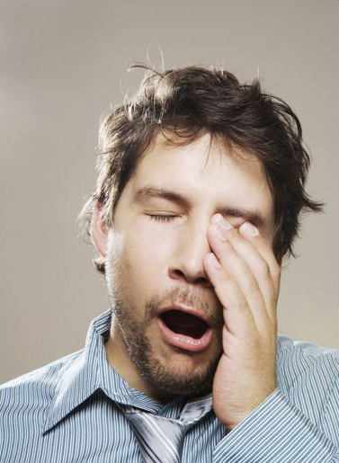
Go to sleep early & arrive early to church
Notes:
One way is to arrive early for personal prayer. At many churches you must arrive at least 15 minutes early to get a parking space—and this is good of us in worship too.

Slide 22

Pray in natural settings
Notes:
I’m also a fan for prayer in natural settings. Some of my most precious times of prayer have been near the ocean, a lake, in the forest, etc. Susan and I pray as we walk through the Botanic Gardens.

Slide 23
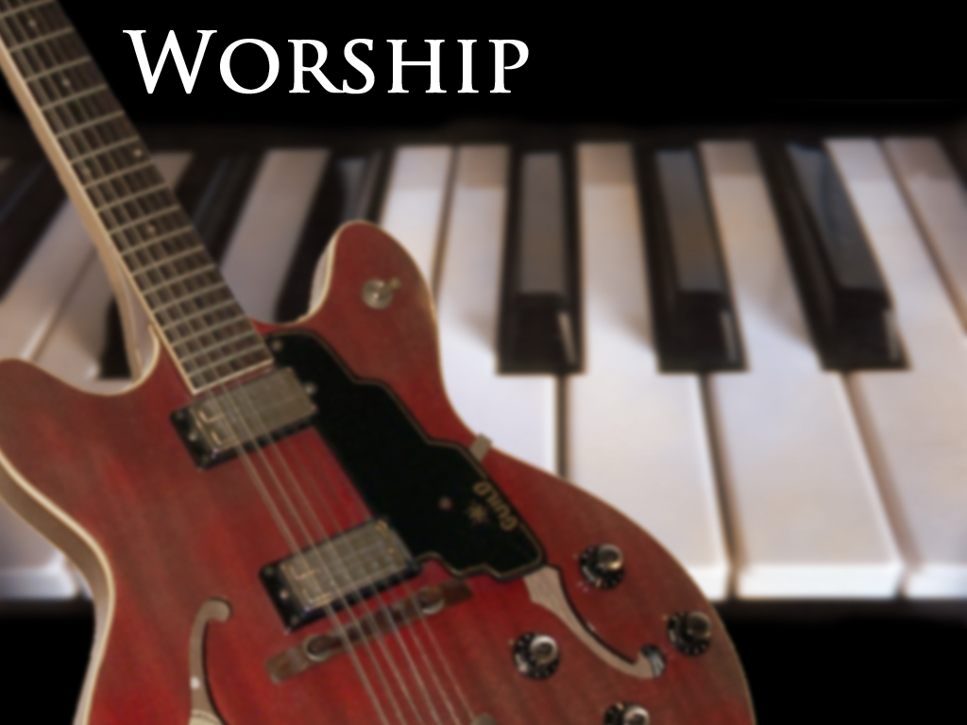
Play background worship music
Notes:
Another way I find helpful to prepare myself to meet the Lord is to pray with worship music in the background. Soft music has a way of quieting our spirits to meet with God and be ready for what He has to tell us.

Slide 24
How to honor God in worship
Prepare yourself
Listen to God

Slide 25
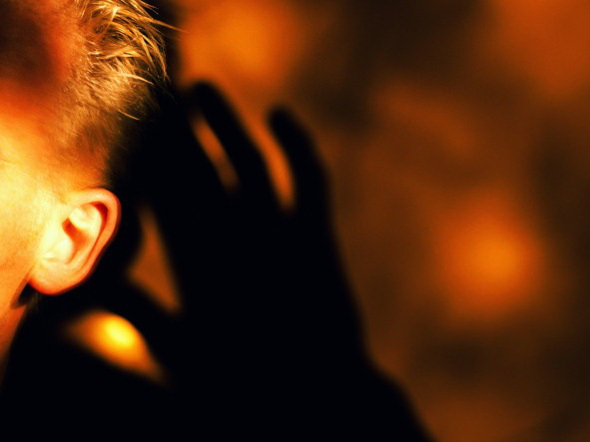
Listen to God (5:1b-2)
"Go near to listen rather than to offer the sacrifice of fools, who do not know that they do wrong."

Slide 26
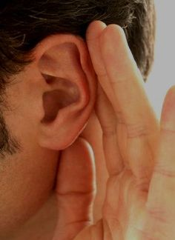
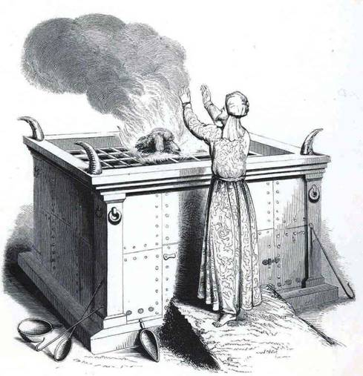
What does God want more? For us to listen or sacrifice?

Slide 27
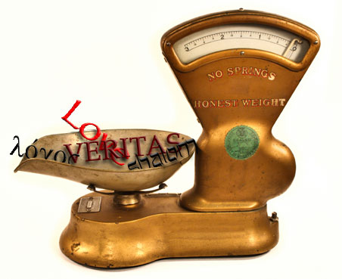
Weigh your words and thoughts carefully because of who God is (5:2).
Website

Slide 28

        "Do not be quick with your mouth, do not be hasty in your heart to utter anything before God"
        (5:2a NIV).

Slide 29
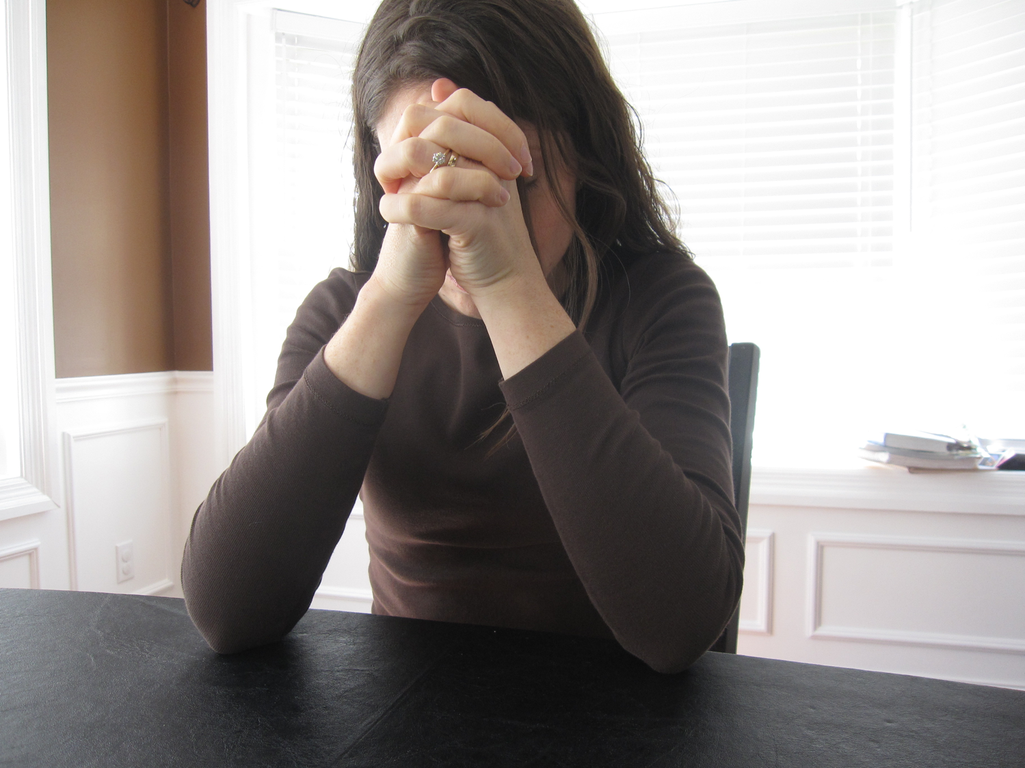
        "Do not be quick with your mouth, do not be hasty in your heart to utter anything before God"
        (5:2a NIV).

Slide 30

        "Do not be quick with your mouth, do not be hasty in your heart to utter anything before God"
        (5:2a NIV).

Slide 31
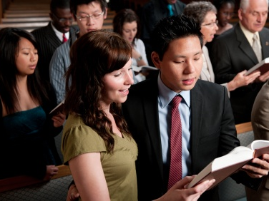
        "Do not be quick with your mouth, do not be hasty in your heart to utter anything before God"
        (5:2a NIV).

Slide 32

        "Do not be quick with your mouth, do not be hasty in your heart to utter anything before God"
        (5:2a NIV).
        "I Surrender All"

Slide 33
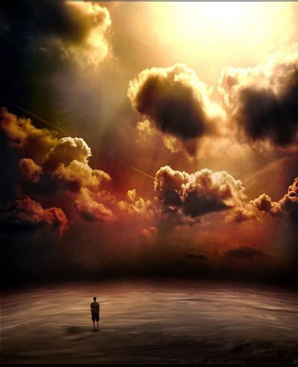
Awesome God, puny man
        "God is in heaven and you are on earth…"
        (5:2b NIV).
Notes:
Realize God is awesome and majestic and you are puny in comparison (5:2b).
God dwells in heaven in unapproachable light in impeccable holiness!
We're confined to but a tiny, rotating ball among the millions of planetary creations. How can we earthlings be so presumptuous as to barge our way mouth-first into His awesome presence?

Slide 34
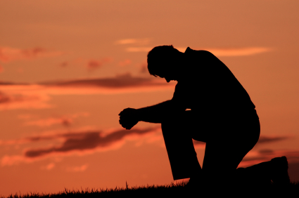
"…so let your words be few" (5:2c)

Slide 35
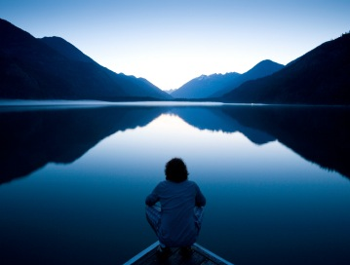
Psalm 46:10
"Be still and know that I am God."
Pre-Service Meditation

Slide 36
How to honor God in worship
Prepare yourself
Listen to God
Set aside cares
Notes:
We do well to have times when we listen by keeping our mouths shut. After all, who can listen while he's babbling away? This is God's intent in Psalm 46:10 where He says, "Be still and know that I am God."
I've found that's a tough assignment, but one thing has helped. Get ready for us to try this in this church. We will project a Scripture verse up front for pre-service meditation during the prelude as a sign to take our seats and prepare to worship. I've seen how this reminds people to remember that they have come to listen rather than speak.

Slide 37
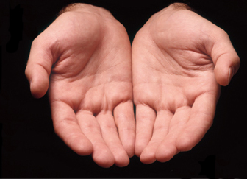
"As a dream comes when there are many cares, so the speech of a fool when there are many words" (5:3 NIV).
Notes:
What we need is more care-less worship. Notice said "care-less" not "careless."

Slide 38
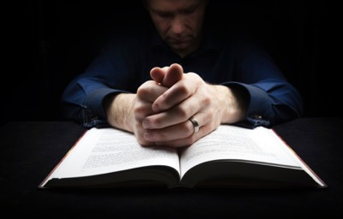
Wandering… What to do?
Notes:
I confess to you that I really struggle with keeping my mind from wandering in prayer. I start off real well, but after ten or fifteen seconds I begin thinking about an errand I need to do, an event that happened yesterday, or whatever. Do you have this problem? Let me give you a few suggestions:

Slide 39
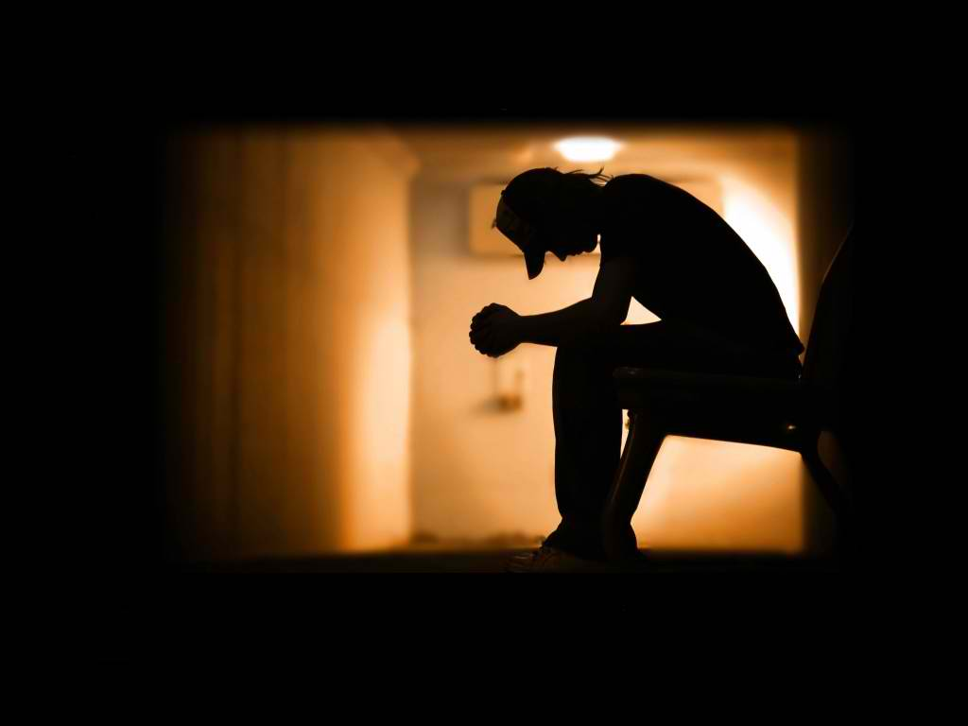
Sitting in Prayer

Slide 40
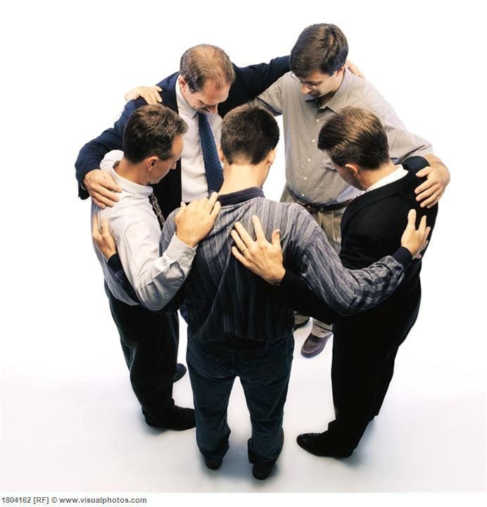
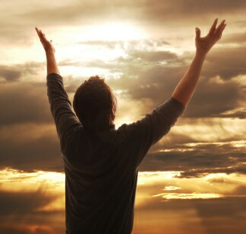
Pray standing up!

Slide 41
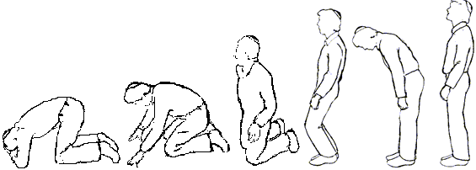
How did they pray in the Bible?

Slide 42

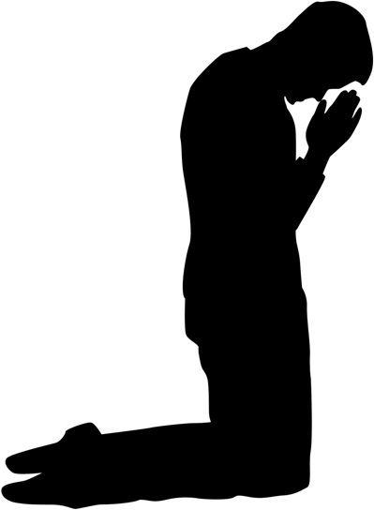

Scriptural Positions of Prayer

Slide 43
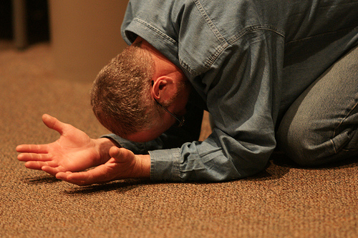
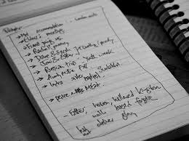
Use Lists

Slide 44
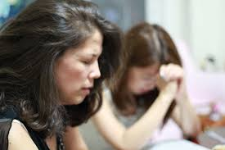
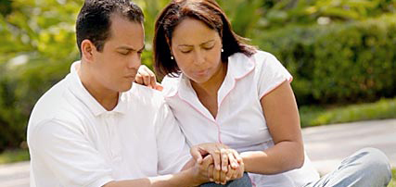
Pray with someone else

Slide 45
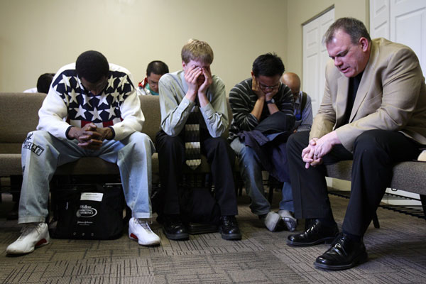
Pray with someone else

Slide 46
I. Honor God in your worship (1-3).

Slide 47
How to honor God in worship
Prepare yourself
Listen to God
Set aside cares

Slide 48
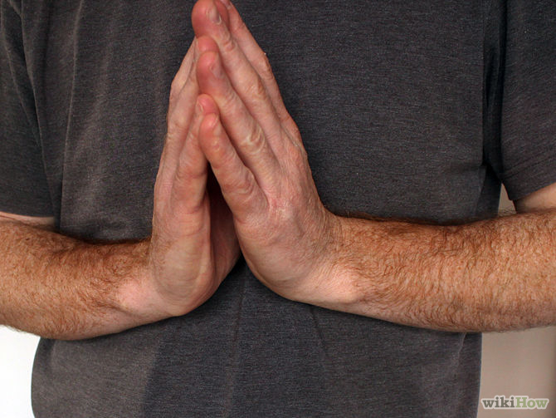
II. Honor God in your vows (4-7).
Notes:
If we truly respect the Lord in worship, we must keep our promises.

Slide 49
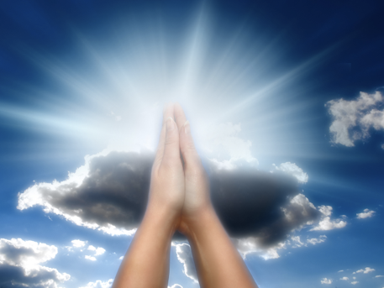
    "When you make a vow to God, do not delay in fulfilling it. He has no pleasure in fools; fulfill your vow" (5:4 NIV).

Slide 50
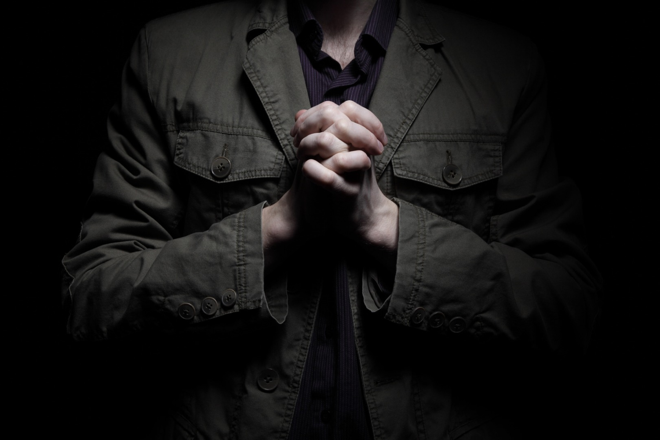
What is a Vow?
"an unconditional, solemn promise to do or not to do something."

Slide 51
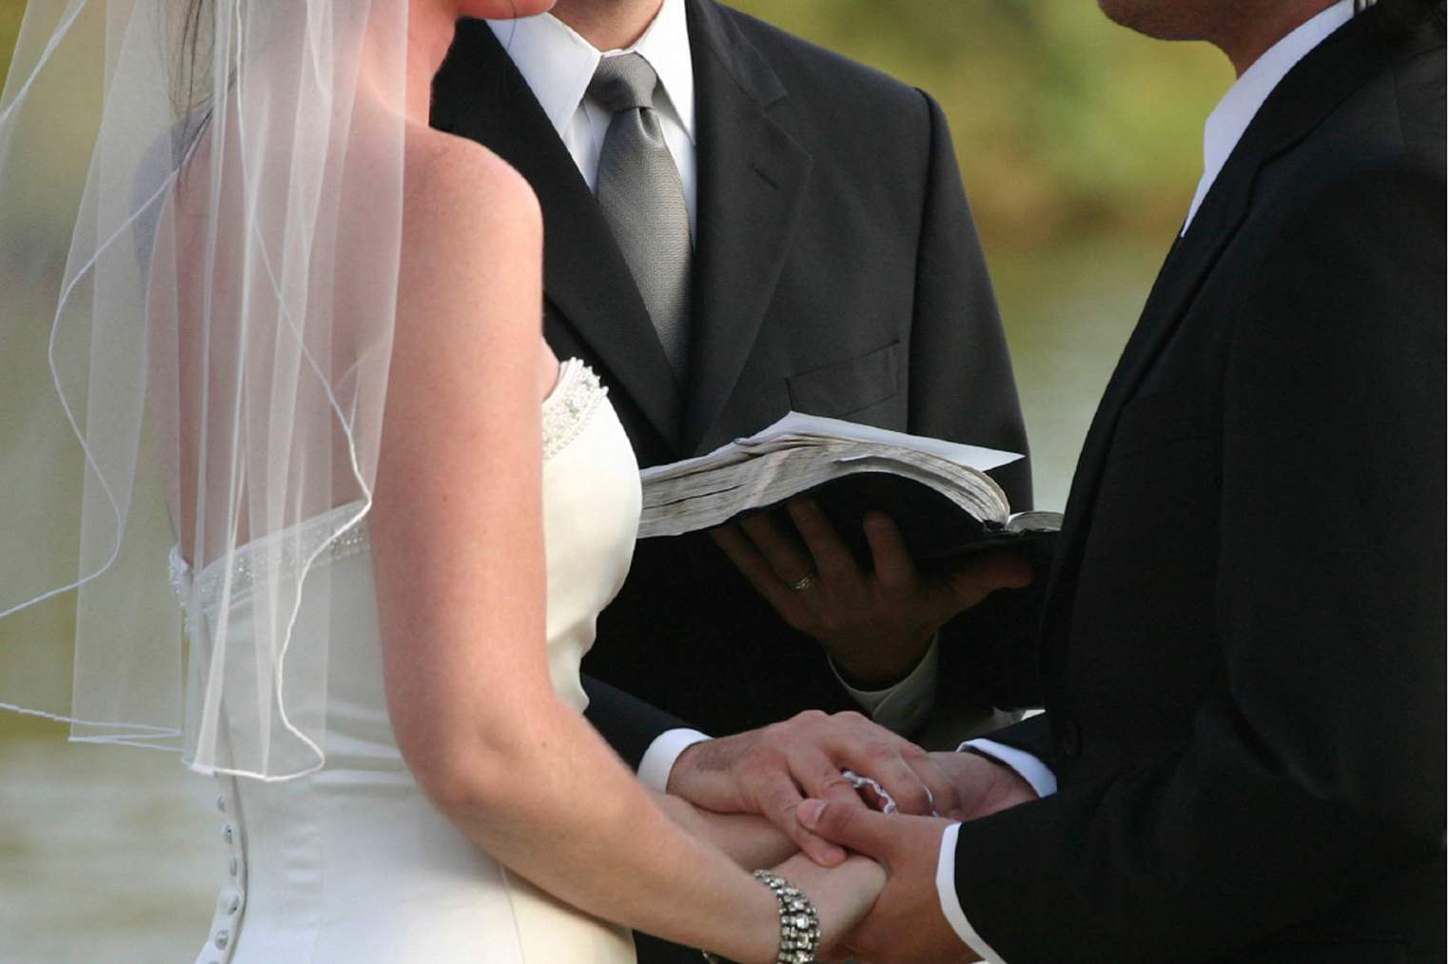
Wedding Vows

Slide 52

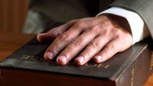
My Vows
Sexual purity
Read Bible 5 min./day
Never divorce Susan
Serve God anywhere
Church membership
Giving
Notes:
That's what I think it means by a "vow."
It doesn’t mean every single expression of intent, but a serious promise before God.
Notice that each affirmation is voluntary. No one ever has to vow! In fact…

Slide 53
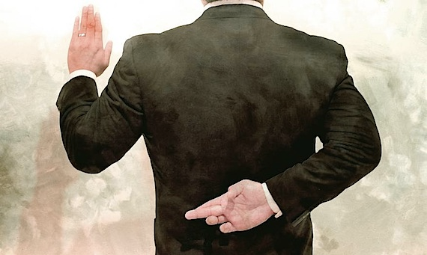
"It is better not to vow than to make a vow and not fulfill it" (5:5 NIV).
No vow at all is better than an unfulfilled vow.

Slide 54


Covenant 1 of 5
The Crossroads Church Covenant
Notes:
54
Let us commit together…

Slide 55
Covenant 1 of 5
We, the members of
CROSSROADS INTERNATIONAL CHURCH LTD.,
attest that we have received Jesus Christ as Savior and Lord and have submitted to believer's baptism, and that we have voluntarily joined the CROSSROADS INTERNATIONAL CHURCH LTD and pledged to abide by the provisions of this covenant with the help of the Holy Spirit.
Notes:
55
Let us commit together…

Slide 56
Covenant 2 of 5
As members of one body, we pledge to:
guard its doctrinal purity defined in the Doctrinal Statement
uphold the Constitution and abide by its provisions
support its mission of making disciples of all nations
participate in its evangelistic, educational, and edifying programs through faithful attendance and financial support
Notes:
56

Slide 57
Covenant 3 of 5
respect its duly constituted leadership
preserve its organizational and spiritual unity
submit to the standard of New Testament church discipline
love and serve one another according to Christ's example
provide financial support to CIC willingly and cheerfully as God has prospered us
Notes:
57

Slide 58
Covenant 4 of 5
maintain a personal program of spiritual development through prayer and Bible study
engage in personal witnessing for Christ in word and deed
uphold a high standard of morality in personal, public, business, and family life
abstain from habits and activities which are harmful to the body, binding to the will, damaging to Christian witness, and not glorifying to God
Notes:
58

Slide 59
Covenant 5 of 5
resolve all conflicts with arbitration only among believers without recourse to the secular courts
bear one another's burdens, rejoice with those who rejoice, sympathize with those who hurt, and encourage the weak
be slow to take offense, quick to secure reconciliation, and show consideration of the personal convictions of other members;
and transfer our membership to a church with practices similar to these, which we now uphold, when we move to another place
Notes:
59

Slide 60
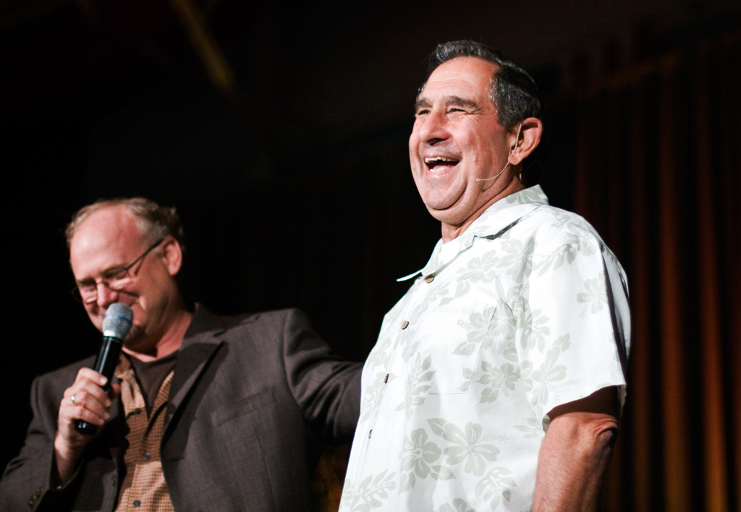
Dr. Don Sunukjian
Notes:
One of my seminary profs was really challenged on a vow that he made.
His name is Dr. Sunukjian. He once told me that he really wanted to teach at DTS, but after ten years of school there and the Th.D., the Pastoral Ministries department told him that he needed a Ph.D. He got his Ph.D. from UCLA and called the seminary. They told him, "Great! But you need some practical experience first. So he pursued a pastorate, but was of the conviction that if it took a unanimous vote of the elders to get him in the church, then it should take a unanimous vote to get him out! So he made an agreement with the church not to leave until the entire board approved.
Only two years into that pastorate, he got a call from Dallas Seminary, offering him a faculty position. This was the opportunity he'd anticipated for years, and he shared it with great excitement to the board—but they didn't think he should leave. So he stayed.
Three more years passed, then the telephone rang. Haddon Robinson said on the other end of the line, "Don, we really need you now to replace one of our faculty who's leaving." Again, Sunukjian placed it before the board. Their response? "Pastor, we're just getting going on this building project now. We don't want you to leave yet. The timing's not right." Again, he declined the seminary's offer and held to his vow.
You can't help but admire a man like that who made a promise and stuck to it, even though he never suspected that he'd be at that church seven years. But if he broke his promise, do you think God would easily accept his worship?

Slide 61
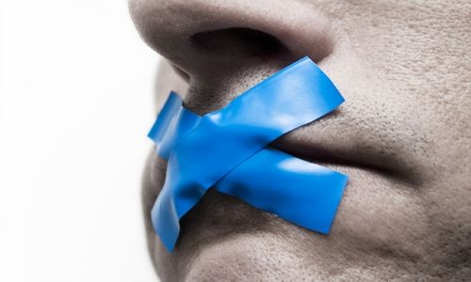
"Do not let your mouth lead you into sin. And do not protest to the temple messenger, 'My vow was a mistake'"
(5:6a NIV).
Notes:
Imagine the Jew confidently offering to the priest a sacrifice for a vow at the temple, only later to be tempted to break it. He rushes back to the priest, “Sorry, I shouldn’t have vowed that! It was just a small goof-up. Can you pull some strings to undo the vow?”
God says, “Don’t do that! You’re not required to make the vow in the first place, but don’t make it worse by going back on the vow and reneging on your commitment!”

Slide 62
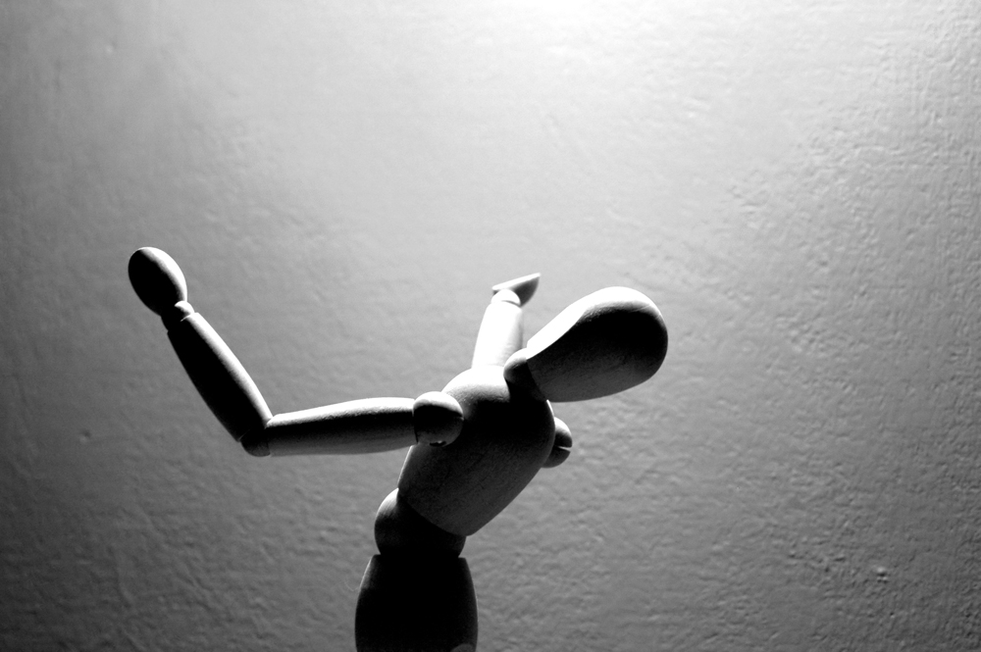
"Why should God be angry at what you say and destroy the work of your hands?” (5:6b NIV).
God's anger at our rash vows may wipe out our achievements and possessions

Slide 63
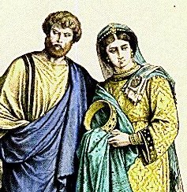
Ananias and Sapphira (Acts 5)
Notes:
They sold some land and promised to give God all the money.
But when that money landed in their hot little hands they had second thoughts about giving it all. “Let’s only give a portion of it,” they agreed together.
God didn’t think too highly of their broken vow. He didn’t just destroy the works of their hands, though. He took their lives!

Slide 64

Do you have an outstanding vow debt?
Time?
Tithe?
Other?

Slide 65
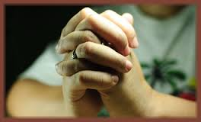
$27 paycheck for the month
Notes:
God has His ways of disciplining His children who neglect paying their pledge.
He once whittled my salary down to a $27 paycheck because I didn't return to Him the percentage of my income that I'd committed. I can't live on $27 for a month!

Slide 66

"Much dreaming and many words are meaningless. Therefore stand in awe of God"
(5:7 NIV).
"Talk is cheap, like daydreams and other useless activities. Fear God instead"
(5:7 NLT).
Fear God without dreaming and making rash vows in worship.

Slide 67

Hebel literally means
"a breath, wind, or vapor"
(Prov. 21:6; Isa. 57:13).
Key Word of Ecclesiastes
Notes:
The word for “meaningless” here literally refers to a vapor.

Slide 68
"Much dreaming and many words are meaningless. Therefore stand in awe of God"
(5:7 NIV).
"Talk is cheap, like daydreams and other useless activities. Fear God instead"
(5:7 NLT).
Fear God without dreaming and making rash vows in worship.
Notes:
Vapor is about how much substance there is to not seriously worshipping Him or being rash and negligent in fulfilling our vows!

Slide 69

"Fear God"
Notes:
This means to show “awe” in His presence—not “blah” in His presence!
Exalt Him, don’t exhaust Him with weary worship or wayward vows.

Slide 70
How can we honor God?

Slide 71

Main Idea of 5:1-7
Honor God in your worship and vows.

Slide 72
"In my worship, I need to…"
Notes:
Stand when I pray?
Use a prayer list?
Pray in a different place or time with fewer distractions?
Come earlier for church?
Listen more than I talk?

Slide 73

"In my vows, I need to…"
Notes:
Husbands, you vowed to treat your wives with understanding and respect.
Did you know that 1 Peter 3:7 says that if you don’t, then your own prayers will be hindered? I assume your worship too!
Have you kept the worship, prayer, or Bible reading vows you have made to Him? These can be renewed, you know.
What other broken promises may be hindering you from genuine worship?

Slide 74

A. W. Tozer,
Worship: The Missing Jewel, 7-8
"Man was made to worship God. God gave to him a harp and said, 'Here above all the creatures that I have made and created, I have given you the largest harp. I put more strings on your instrument and I have given you a wider range than I have given to any other creature. You can worship Me in a manner that no other creature can."

Slide 75
A. W. Tozer,
Worship: The Missing Jewel, 7-8
"And when he sinned, man took that instrument and threw it down into the mud and there it has lain for centuries, rusted, broken, unstrung; and man, instead of playing a harp like the angels and seeking to worship God in all of his activities, is ego-centered and turns in on himself and sulks and swears, and laughs and sings, but it's all without joy and without worship… Worship is the missing jewel in the modern evangelicalism."

Slide 76
Black

Slide 77


OT Preaching link at BibleStudyDownloads.org
Get this presentation and script for free!

